Slide 1
GENDER DETECTION
Presented by: M.HARINI
III year,KVCET
NM ID-au421221243013
Email ID-harinimohan650@gmail.com

Slide 2
PROBLEM STATEMENT
Gender detection from images is a significant problem in computer vision with various practical applications, including security surveillance, marketing analytics, and personalized user experiences.
The task involves identifying the gender (male or female) of individuals depicted in images. This problem is particularly challenging due to the complexity and variability of human facial features.

Slide 3
PROPOSED SYSTEM
Input Image: An input image containing a face is provided to the system.
Preprocessing: The input image may undergo preprocessing steps such as resizing, normalization, and/or face detection to ensure uniformity and improve model performance.
Feature Extraction: The preprocessed image is passed through the convolutional layers of the CNN. These layers extract relevant features from the input image, progressively learning to represent facial characteristics.
Classification: The extracted features are then fed into the fully connected layers, which learn to classify the gender of the individual depicted in the image based on the learned features.
Output: The output layer produces probability scores for each gender class (e.g., male and female). The class with the highest probability score is assigned as the predicted gender of the individual.
Evaluation: The predicted gender is compared with the ground truth label (if available) to evaluate the accuracy and performance of the gender detection system.

Slide 4
PROPOSED SOLUTION
Selection of Convolutional Layers: Convolutional layers are chosen for their ability to automatically learn hierarchical features from raw image data. The depth and width of these layers are determined based on the complexity of the problem and available computational resources.
Activation Function: ReLU activation is preferred due to its simplicity and effectiveness in preventing the vanishing gradient problem. ReLU accelerates convergence during training by enabling faster gradient propagation.
Pooling Layers: Carpooling layers are chosen for down sampling feature maps while retaining the most important information. Carpooling helps in reducing the computational burden and controlling overfitting by discarding irrelevant spatial information.
Optimization Algorithm: Stochastic Gradient Descent (SGD) or Adam optimizer may be used to optimize the network parameters. These optimization algorithms are capable of efficiently navigating the parameter space and converging to optimal solutions.

Slide 5
SYSTEM APPROACH
System Requirements:
Hardware : A computer or server with sufficient computational resources to train and deploy CNN models.
CPU with multiple cores or GPU for accelerated deep learning computations.
Sufficient RAM to handle large datasets and model training operations.
Storage space to store datasets, trained models, and intermediate results.
Software: Deep learning frameworks such as TensorFlow, PyTorch, or Keras for implementing and training CNN models.
Python programming language for scripting and development.
Libraries for image processing (e.g., OpenCV), data manipulation (e.g., NumPy, Pandas), and visualization (e.g., Matplotlib) for preprocessing, analysis, and visualization tasks.
Optional: GPU-accelerated computing resources for faster model training (e.g., NVIDIA CUDA-enabled GPUs).

Slide 6
ALGORITHM AND DEPLOYMENT
Data Preparation:
Load the dataset of facial images and corresponding gender labels.
Preprocess the images by resizing them to a fixed size (e.g., 224x224 pixels), normalizing pixel values, and applying any necessary augmentation techniques (e.g., rotation, flipping, brightness adjustment).
Model Construction:
Define the architecture of the CNN model for gender detection.
Construct the model by stacking convolutional layers followed by activation functions (e.g., ReLU) and pooling layers (e.g., Carpooling).
Add fully connected layers at the end of the network to perform gender classification.
Compile the model with an appropriate loss function (e.g., categorical cross-entropy) and optimization algorithm (e.g., Adam).
Model Training:
Split the dataset into training, validation, and testing sets.
Train the CNN model using the training set, validating the performance on the validation set.
Monitor training progress by tracking metrics such as accuracy and loss.
Fine-tune model hyperparameters (e.g., learning rate, dropout rate) based on validation performance.

Slide 7
4. Model Evaluation:
Evaluate the trained model on the testing set to assess its generalization performance.
Calculate performance metrics such as accuracy, precision, recall, and F1-score.
Analyze the confusion matrix to understand the model's strengths and weaknesses in gender detection.
5. Deployment:
Deploy the trained CNN model in a production environment for real-time gender detection.
Integrate the model into an application or system using appropriate deployment methods (e.g., containerization, REST API).
Provide a user-friendly interface for interacting with the deployed model (e.g., web application, command-line interface).
Implement monitoring and logging mechanisms to track model performance and detect potential issues in deployment.

Slide 8
Problem formulation:
Let ={1,2,...,}X={x1​,x2​,...,xN​} be the dataset of facial images, where xi​ represents the ith image.
Each image xi​ is associated with a binary gender label yi​, where ∈{0,1}yi​∈{0,1}, representing male (0) or female (1).
The task is to learn a mapping :→f:X→Y, where ={0,1}Y={0,1}, such that the model accurately predicts the gender label ^y^​i​ for each input image xi​.

Slide 9
Data Exploration:
Dataset collection.
Exploratory data analysis (EDA).
Algorithm Selection and Implementation:
Utilizing Convolutional Neural Networks (CNNs).
Training and validation.
Model evaluation.
Deployment:
Integration into application.
Scalability and reliability.
Continuous improvement.

Slide 10
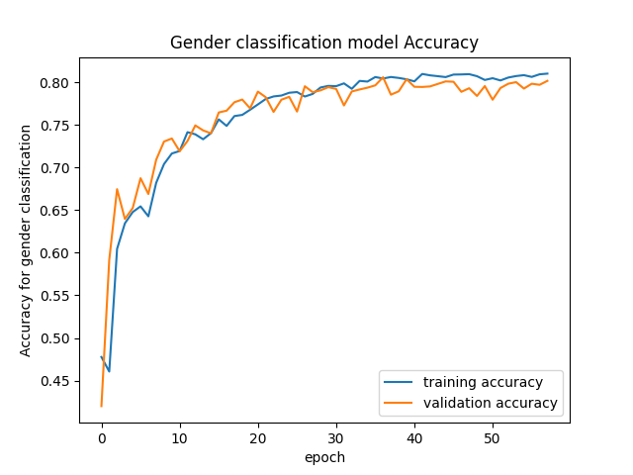
RESULT Accuracy:80%

Slide 11
CONCLUSION
Gender detection using Convolutional Neural Networks (CNNs) presents a promising approach for accurately classifying the gender of individuals depicted in facial images.
In this analysis, we explored the problem formulation, algorithm selection, and considerations for developing a robust gender detection system. We defined the problem of gender detection as the task of accurately classifying the gender labels (male or female) associated with facial images. The objective is to develop a CNN-based model that can generalize well to unseen data and handle variations in facial expressions, lighting conditions, and other factors commonly encountered in real-world scenarios.

Slide 12
FUTURE SCOPE
While CNNs have shown promising results for gender detection, there are opportunities for further research and improvement. Future directions may include exploring techniques for domain adaptation, mitigating bias and fairness considerations, and integrating multimodal information (e.g., facial expressions, voice) for enhanced gender classification.
In conclusion, gender detection using CNNs holds great potential for various applications, including security surveillance, marketing analytics, and user experience personalization. By addressing the challenges and considerations outlined in this analysis, developers can create accurate, efficient, and reliable gender detection systems that meet the diverse needs of users and stakeholders.

Slide 13
REFERENCES
Parkhi, O. M., Vedaldi, A., & Zisserman, A. (2015). Deep Face Recognition. British Machine Vision Conference.
Schroff, F., Kalenichenko, D., & Philbin, J. (2015). FaceNet: A Unified Embedding for Face Recognition and Clustering. Proceedings of the IEEE Conference on Computer Vision and Pattern Recognition.
Taigman, Y., Yang, M., Ranzato, M., & Wolf, L. (2014). DeepFace: Closing the Gap to Human-Level Performance in Face Verification. Proceedings of the IEEE Conference on Computer Vision and Pattern Recognition.
Zhang, K., Zhang, Z., Li, Z., & Qiao, Y. (2016). Joint Face Detection and Alignment Using Multitask Cascaded Convolutional Networks. IEEE Signal Processing Letters.
Deng, J., Guo, J., Xue, N., & Zafeiriou, S. (2019). ArcFace: Additive Angular Margin Loss for Deep Face Recognition. Proceedings of the IEEE Conference on Computer Vision and Pattern Recognition.
Howard, A. G., Zhu, M., Chen, B., Kalenichenko, D., Wang, W., Weyand, T., ... & Adam, H. (2017). MobileNets: Efficient Convolutional Neural Networks for Mobile Vision Applications. arXiv preprint arXiv:1704.04861.

